Slide 1
Embedded Systems Lab Project
Attila Hegedüs
Abbas Vahedi
GROUP 3

Slide 2
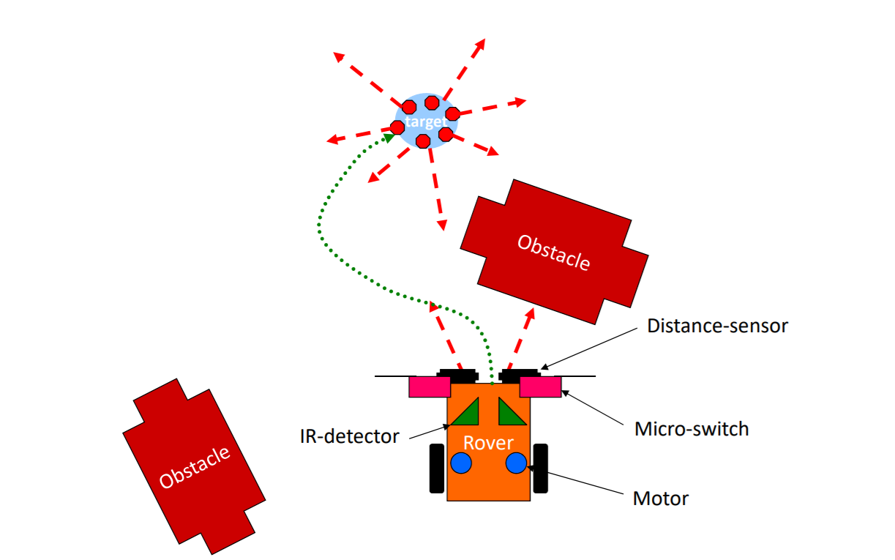
TASK

Slide 3
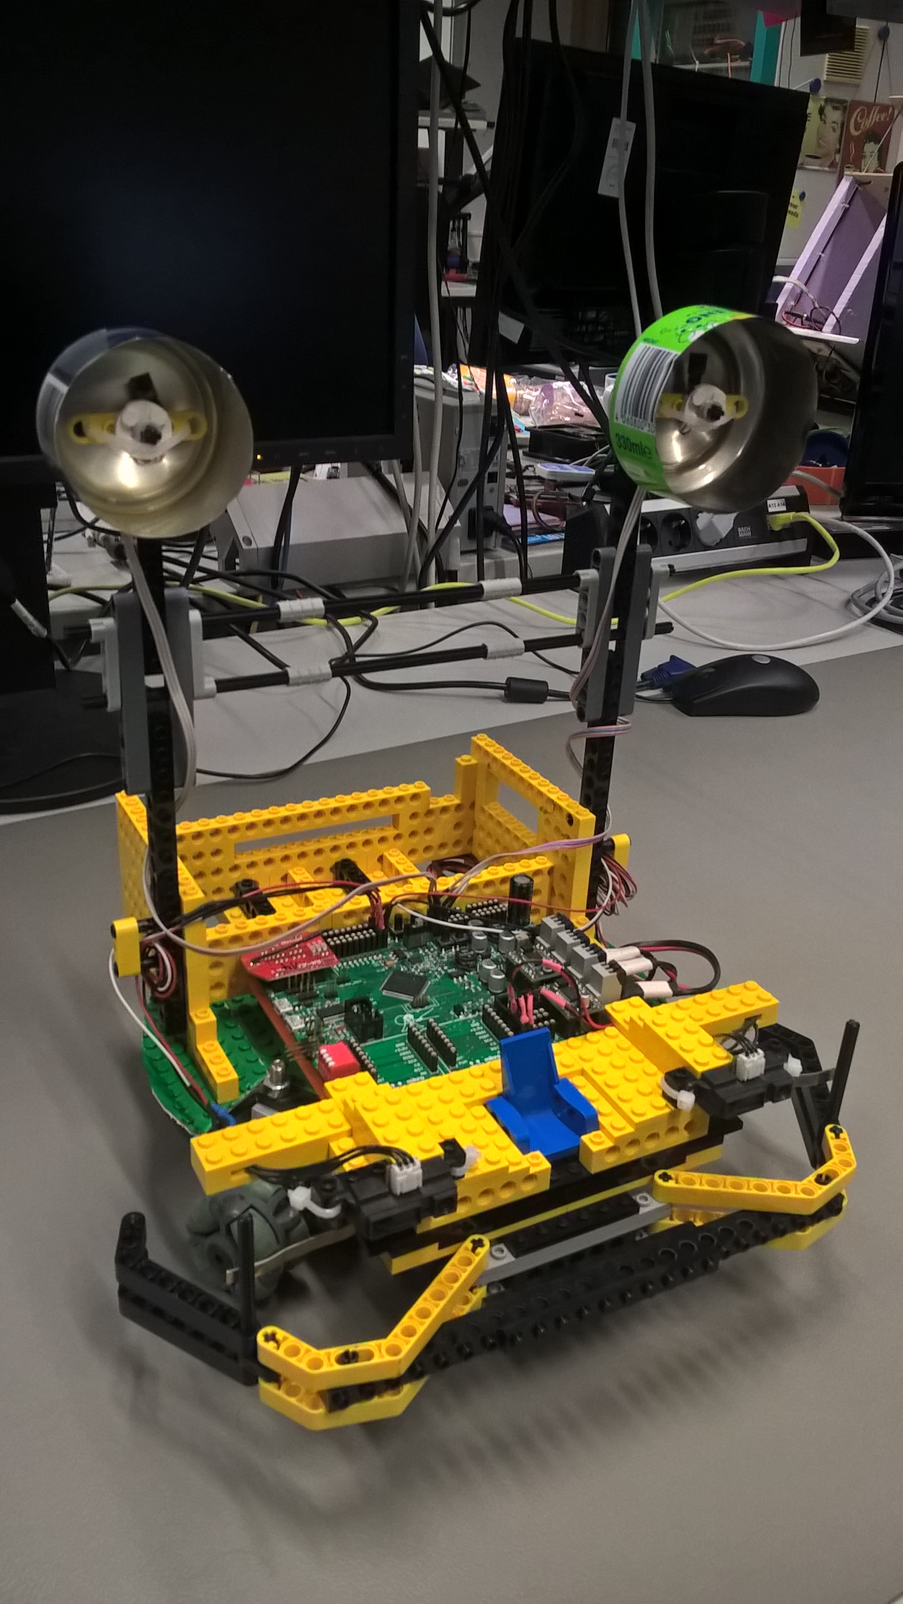
Structure
length = 28Cm & Width = 26 cm & Height = 31cm
2 motors for driving and 1 for controlling system
2 physical boosters and protectors for IR sensor detector(Cans!)

Slide 4
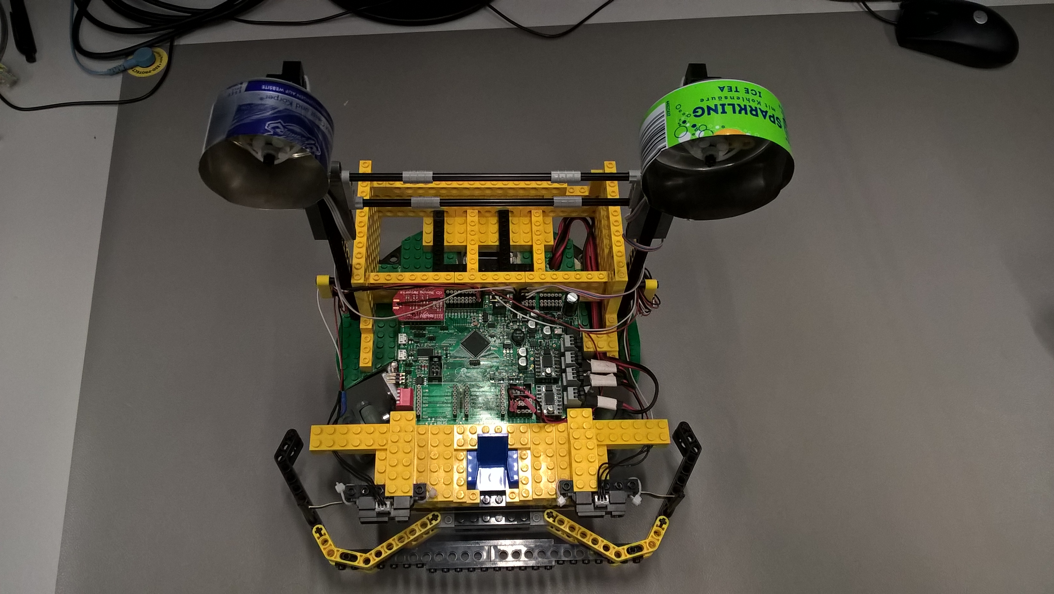
Robot behavior concept to reach the target
initialize
Searching IR signals
Boosts IR signals that receive
Locks on it
Avoided to crash with obstacles
Avoided to stuck into the Corner Trap
Detect Emergency situation and imply rescue function
Try to keep the Direction

Slide 5
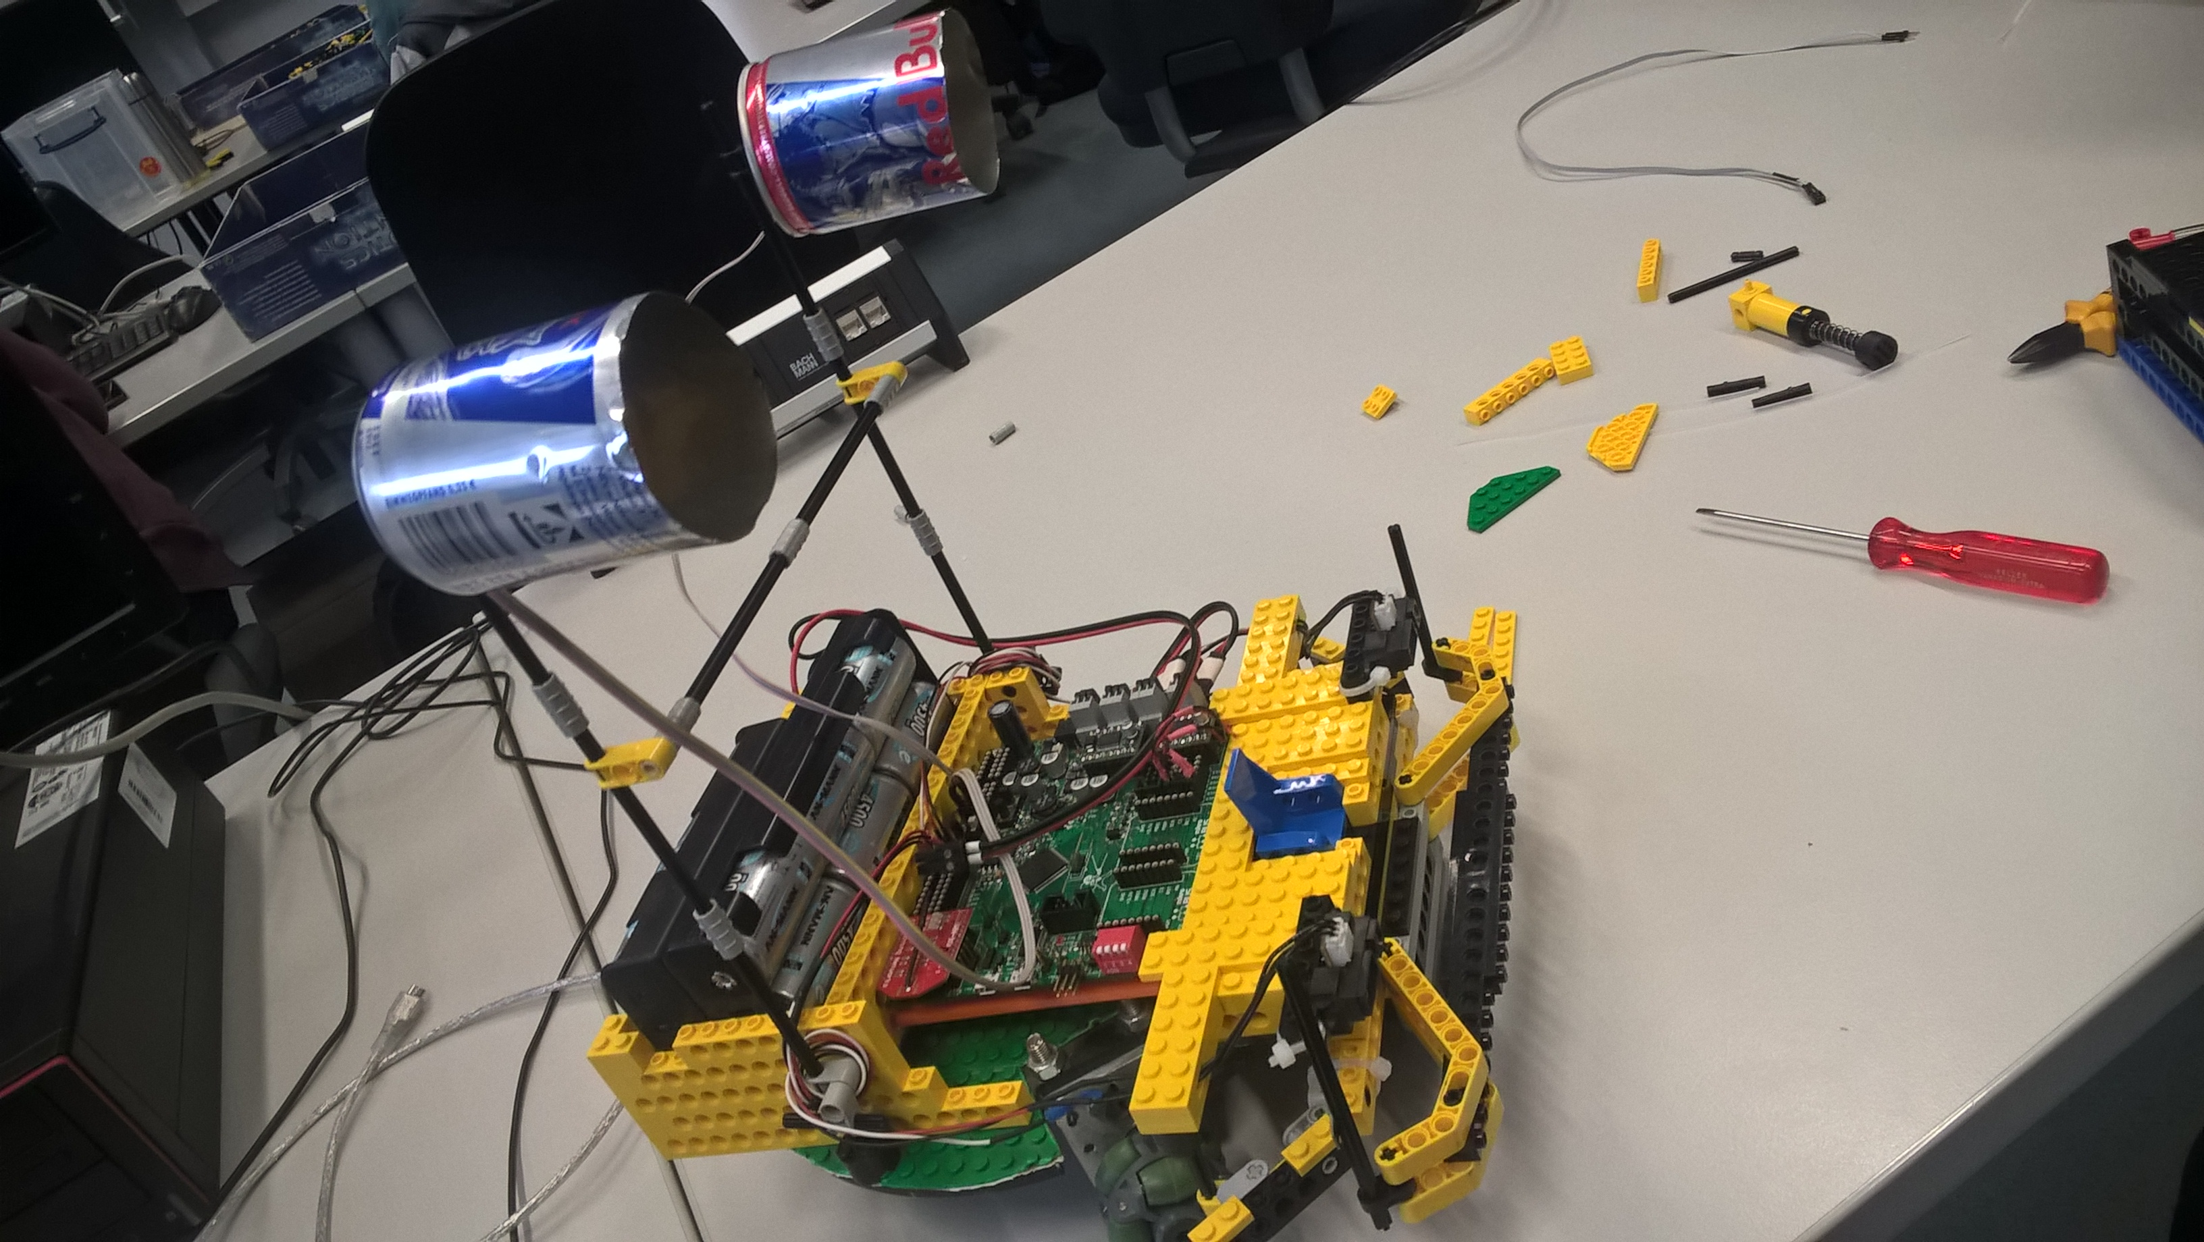
System Design
2 IR sensors on the top at the 31 cm from the surface
2 IR- Distance sensors in front of Robot to detect obstacles at 10 cm before collision
2 Micro switches on the front to detect crashes and act in emergencies.
Calculates Turning Angle
Calculates the Distances

Slide 6
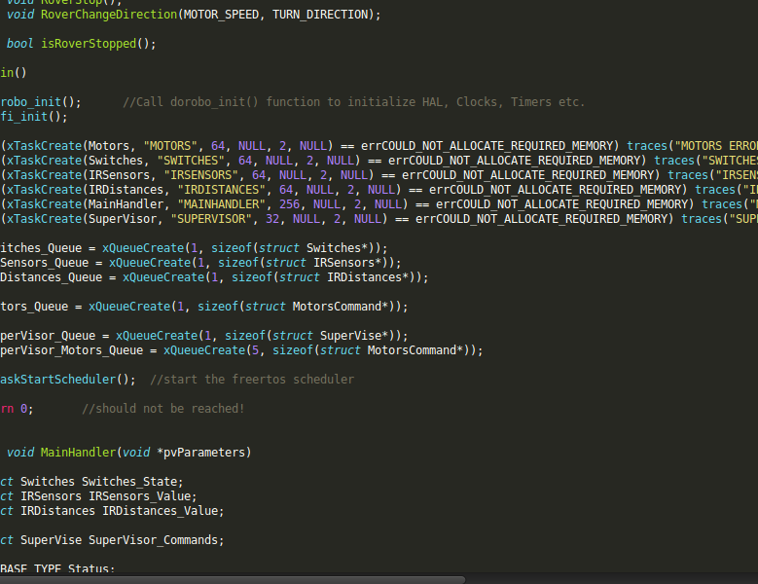
system implementation
Seven simultaneous threads
Inter-thread communication with Queue-s
Separate threads for data collecting, controlling and supervising
Centralized decision-making, movement control
Git-managed codebase

